Slide 1

Software
Upgrade
&
Licence
Milpo
Online
Takeaway
NetShop
Remote
Support
Logon to
SuperPOS
SuperPOS ePOS System Version 3.01 Copyright @ 2014 All Right Reserved Gwenwich (UK) Limited

Slide 2
Control Panel
System Setting
System
Configuration
User
Maintenance
Data Manager
Compact
Database
Computer
Address
Shift Code
Takeaway & Quick Dining Setting
Takeaway
Configuration
Menu Category
Menu Item
Manage
Menu Set
Extra Menu
Edit
Order Control
Department
Code
Table Setup
Print Setup
Caller
Record
Eat In Setting
Eat-In
Configuration
Menu Category
Menu Item
Manage
Menu Set
Extra Menu
Edit
Order Control
Department
Code
Table Setup
Printer
Order Entry
Print Setup
Reporting
Account
Summary
Reports
System
Control
Exit

Slide 3
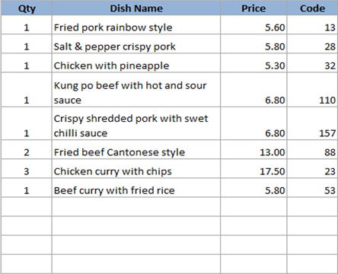
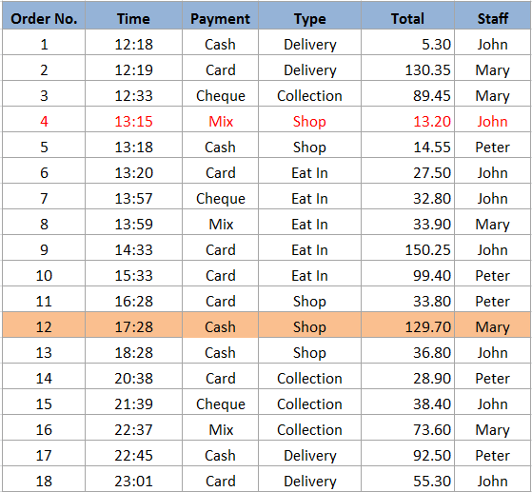
Account Summary
When pressing CTRL SHIFT-P, it shows the Account Summary Management Page (see next page)
Void Order the Payment column will show Voided, its amount won’t appear on the end of day total
Amend Order will go to order taking page, day and time remain original info.
Change Payment – to change payment type, cash to card….
Summary View
Print Sales Report
Print
Receipt
Print
Bill
Print
Kitchen
Paper
Print
Account
Summary
Delivery Charge : 2.50
Cust
Info
Discount : 3.80
Surcharge : 1.00
Total T/A
Collection
Delivery
Shop
Eat In
Items
11
Total Amount
129.70
1675.50
365.35
813.60
533:30
1288.00
LANGUAGE
Amend
Order
Void
Order
Change
Payment
Total Takings
Total Order
D /C
S /C
Exit
Date
08/05/2015
2930.55
18
28.00
108.90

Slide 4
Account Summary
Amend
Order
  Amend the content of a complete order. Amended order will be show as RED
Print
Receipt
  Print receipt to customer. After receipt printed, the order will be shown in BOLD

Slide 5
Account Summary Management
Current Time
Current Date
Print All Orders – print individual customer bills of the day again
Archive Day Record is to erase all orders of the day
Void With New Numbers – delete highlighted orders and then re-arrange the order numbers. Void With Numbers – keep the original order numbers
Once selected will be highlighted. Orders shows 1 order is selected.
Amount is the total amount of selected invoices.
Total Amt (also called remaining amt) is total amount after the those highlighted orders are deleted
Order Qty is the total quantity after those highlighted quantity are deleted
18:35:36
08/12/2014
Refresh
Orders
Print
Account
Summary
Void With
New Numbers
Amend
Order
Void With
Numbers
Print
All Orders
Archive
Day
Record
Date
08/12/2014
Selected
Remaining
Emulate
488.90
1000.00
1488.90
Orders
Amount
Order Qty
Total Amt
Exit
1
129.70
8
433:30
LANGUAGE

Slide 6
Account Summary Management
  If the user press “Total”, it will sort Ascending or Descending… Same for other columns

Slide 7
Summary View
Takeaway Summary
Current Time
Current Date
Total TA
Collection
Delivery
Shop
18:35:36
08/12/2014
1675.50
365.35
813.60
533:30
Total Order
Total Col
Total Del
Total PU
Export
CSV
68
28
20
20
D /C
Not Paid
28.00
Order
1
Total
3.30
Eat In Summary
Cash
S /C
Total Order
Order
12
Total
123.30
Total Eat In
1288.00
108.90
30
Card
Order
22
Total
323.30
Tips
23.30
Summary Total
Cheque
Order
2
Total
323.30
Tips
28.00
Total Takings
Total Order
Total VAT
2930.55
98
295.85
LANGUAGE
Exit

Slide 8
Print Sales Report
Current Time
Current Date
18:35:36
08/12/2014
January 2014
From Date
08/12/2014
Sun
Mon
Tue
Wed
Thu
Fri
Sat
To Date
08/12/2014
29
30
31
1
2
3
4
5
6
7
8
9
10
11
From Time
00:00
12
13
14
15
16
17
18
To Time
23:59
19
20
21
22
23
24
25
26
27
28
29
30
31
1
Print
Summary
View
Summary
Only
LANGUAGE
Exit

Slide 9
Reports
Menu Item Delete Report
Menu Item Listing
Food Category Performance
Top Items Sales Report
Print Customer Database
Exit

Slide 10
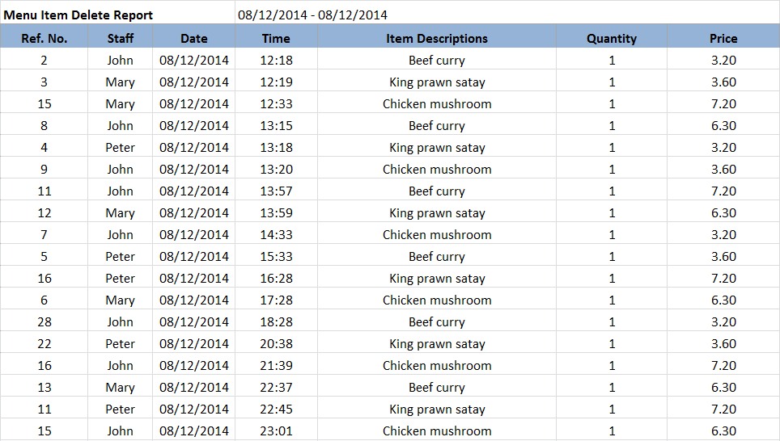
Print (A4)

Slide 11
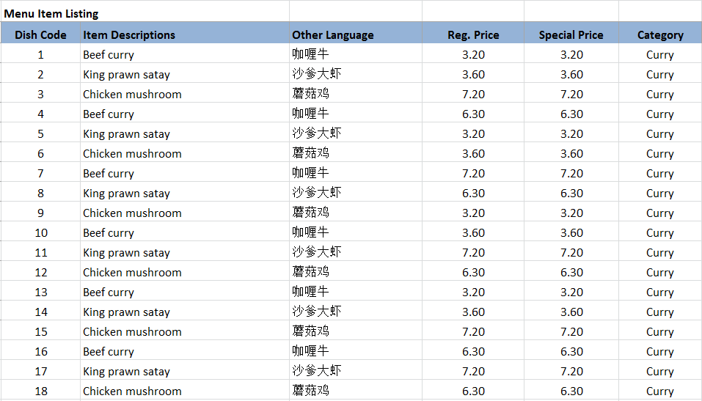
Print (A4)
Eat In
Takeaway
Refresh

Slide 12
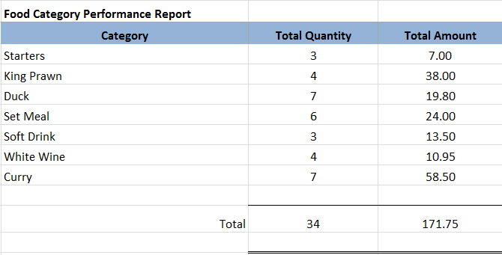
Print (A4)
Eat In
Takeaway
Refresh

Slide 13
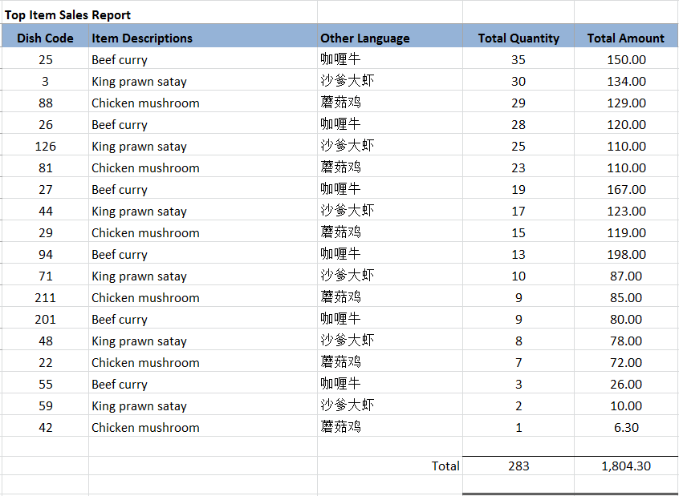
Print (A4)
Eat In
Takeaway
Refresh

Slide 14
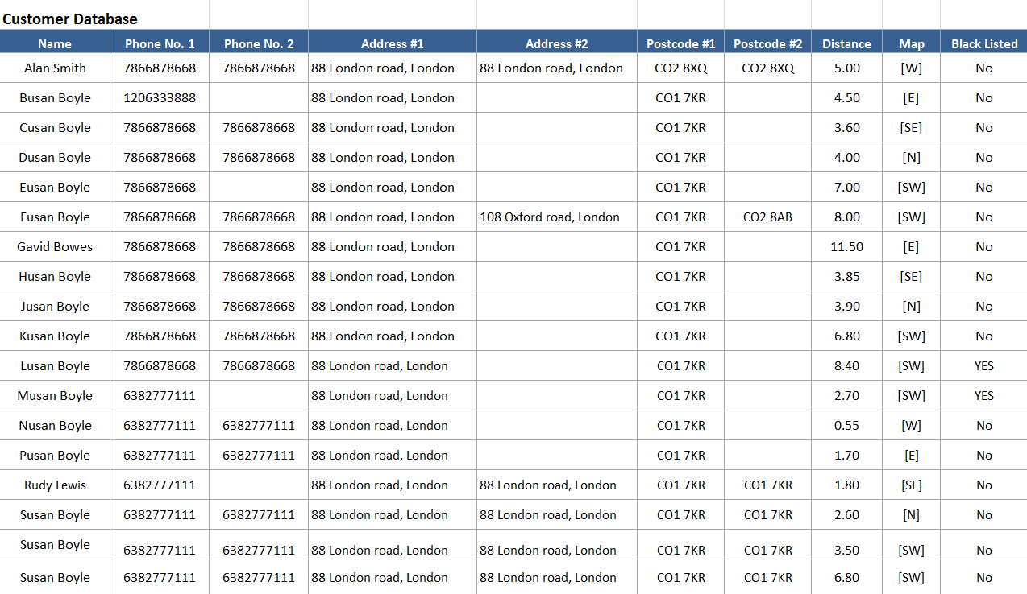
Print (A4)

Slide 15
END
(Slides beyond this page are for references only)

